Slide 1

Course Recap
February 14, 2023

Slide 2
Overview for today’s lecture
Update in Course Grading
Unit 1 recap
Final project recap
Unit 2
Download dataset from GEO
Steps in Job submission – SLURM
Commands overview
Expectation/Output
Conda Download
Data management

Slide 3
Overview for today’s lecture
Update in Course Grading
Unit 1 recap
Final project recap
Unit 2
Download dataset from GEO
Steps in Job submission – SLURM
Commands overview
Expectation/Output
Conda Download
Data management

Slide 4
Change in Final Grade
Homework | 40%
Final Project | 30%
Primary article review/reflection | 20%
Class Participation & Attendance | 10%
Total | 100%

Slide 5
Change in Final Grade
Homework | 50%
Final Project | 30%
Primary article review/reflection | 10%
Class Participation & Attendance | 10%
Total | 100%

Slide 6

Primary literature summary #1 due
scRNA-Seq
scRNA-Seq primary literature review #2 due
Final Project presentation #1

Slide 7
Primary literature summary #1 due
scRNA-Seq
1 homework or 2 “mini” homework
Final Project presentation #1

Slide 8
Overview for today’s lecture
Update in Course Grading
Unit 1 recap
Final project recap
Unit 2
Download dataset from GEO
Steps in Job submission – SLURM
Commands overview
Expectation/Output
Conda Download
Data management

Slide 9
Shell
A shell is a command line interpreter, used to launch software in Linux
There are many different shells available:
BASH
CSH
ZSH etc.
Most software will work the same in all shells
Some functions and automation are different between shells
We have been using the most popular shell, BASH

Slide 10
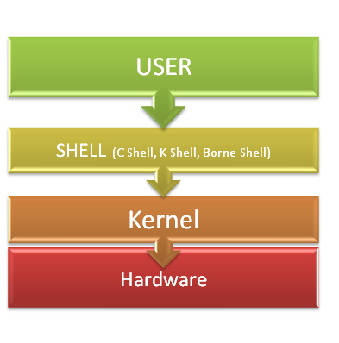
Operating system
Just like Windows, MacOS, Linux is an operating system
VACC is built on a LINUX server built on a LINUX operating system

Slide 11
Running programs
Type the name of the program you want to run
Add on any options the program needs
Press return - the program will run
When the program ends control will return to the shell

Slide 12
Running programs
student@ip1-2-3-4:~$ ls
Desktop Documents Downloads examples.desktop Music Pictures Public Templates
student@ip1-2-3-4:~$
Command prompt - you can't enter a command unless you can see this
The command we're going to run (ls in this case, to list files) The output of the command - just text in this case

Slide 13
The structure of a unix command
ls -ltd --reverse Downloads/ Desktop/ Documents/
Program name
Switches
Data (normally files)
Each option or section is separated by spaces. Options or files with spaces in must be put in quotes.

Slide 14
But what happens if you need or want to install a program on the VACC?
You can do this by following the program instructions, however, make sure the program you are installing is correct for the operating system we are using!

Slide 15
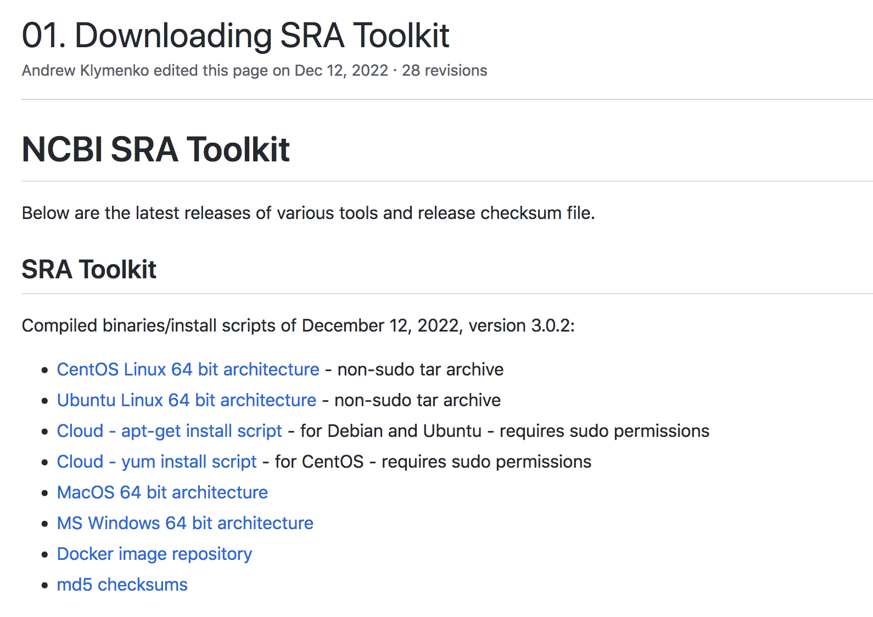

Slide 16









Slide 17
Overview for today’s lecture
Update in Course Grading
Unit 1 recap
Final project recap
Unit 2
Download dataset from GEO
Steps in Job submission – SLURM
Commands overview
Expectation/Output
Conda Download
Data management

Slide 18

Green Mountain Trail

Slide 19
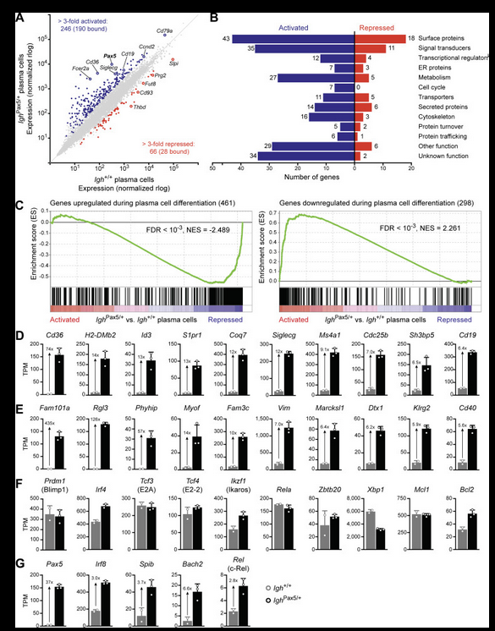
Green Mountain Trail
Your overall goal should be to replicate a Figure or Figure panel (A-C) from a peer-reviewed article

Slide 20
Green Mountain Trail
Perhaps you never truly understood what an Enrichment Score (ES) is?

Slide 21
Green Mountain Trail
How would you label this MA plot?

Slide 22
Green Mountain Trail
Do you know TPM means?

Slide 23

Blue Sky Trail

Slide 24
The bioinformatic pipeline we will learn in class is:
MMG232 | What it does…
FASTQC | Quality control FASTQC files
Trimmomatic | Trim adaptors and low quality reads
HISAT2 STAR | Alignment to Genome
SAMtools | SAM to BAM
HTSeq-count | Create counts files

Slide 25
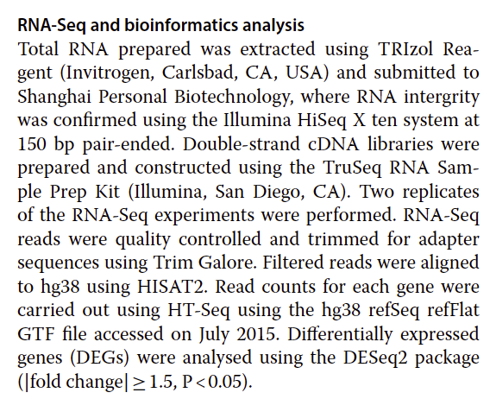
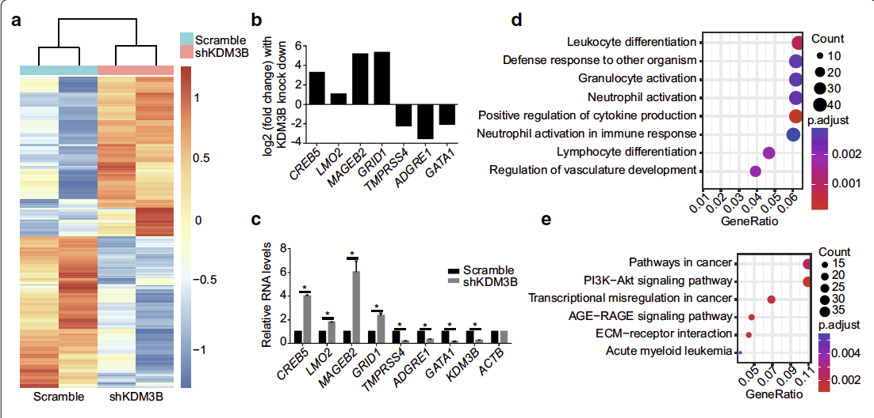
FASTQC
Trimmomatic
HISAT2 STAR
SAMtools
HTSeq-count DeSeq2
# of DEGs
VERSUS

Slide 26
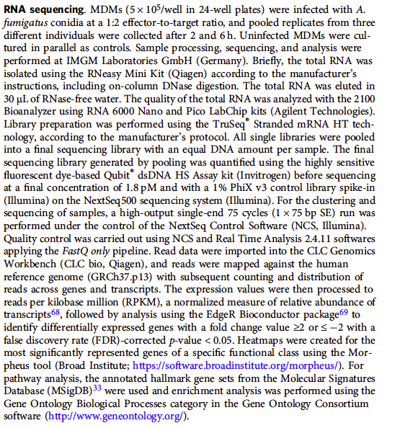
PAPER #2
Very vague methods

Slide 27
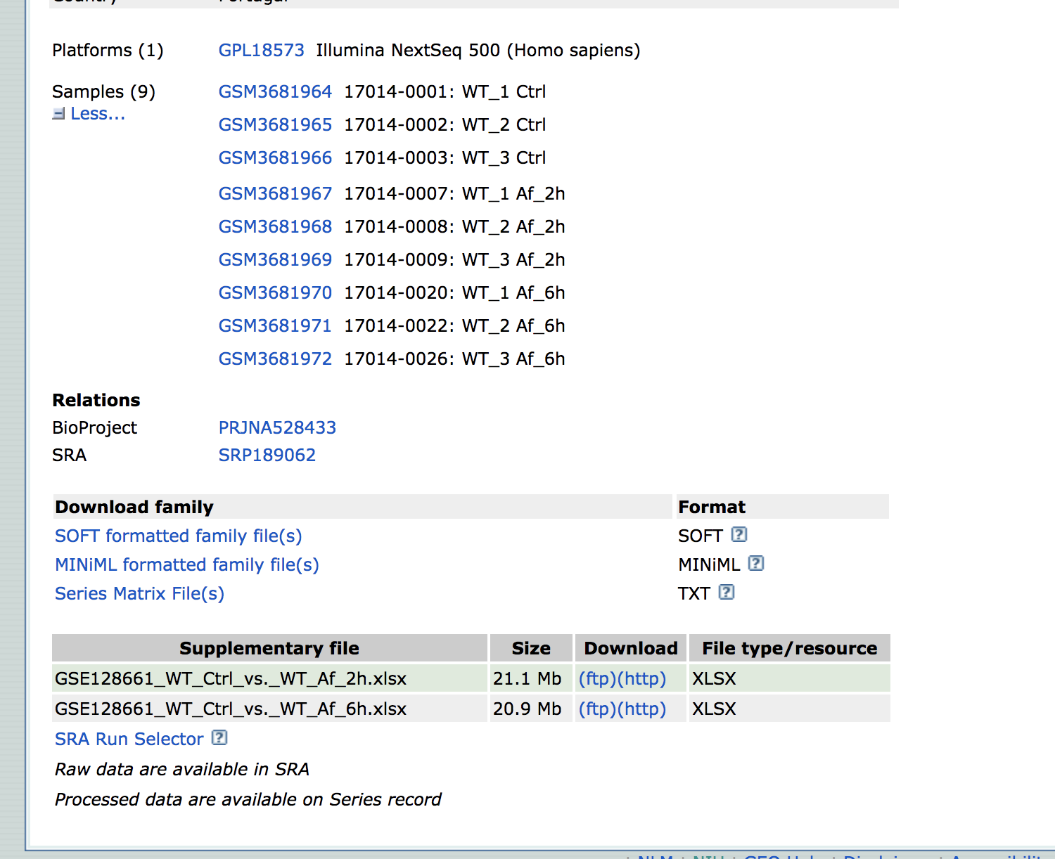
PAPER #2
FASTQC
Trimmomatic
HISAT2
SAMtools
HTSeq-count DeSeq2
VERSUS
# of DEGs

Slide 28

Black Diamond Trail

Slide 29
The approach is different
You are going in with a question and using the dataset to answer this question!
“I am interested in studying the difference in metabolic pathway regulation in macrophage versus dendritic cell activation.”
“I am interested in understanding how inhibition of GATA1 impacts the ability of naïve B cells to differentiate into plasma cells.”

Slide 30
“I am interested in studying the difference in metabolic pathway regulation in macrophage versus dendritic cell activation.”
Dataset | # of replicates
Macrophages (control) | 3
Dendritic cells (control) | 3
Macrophages + LPS | 3
Dendritic cells + LPS | 3
Macrophages + Zeb1 KO | 3
Dendritic cells + Zeb1 KO | 3
Macrophages + Zeb1 KO + LPS | 3
Dendritic cells + Zeb1 KO + LPS | 3

Slide 31
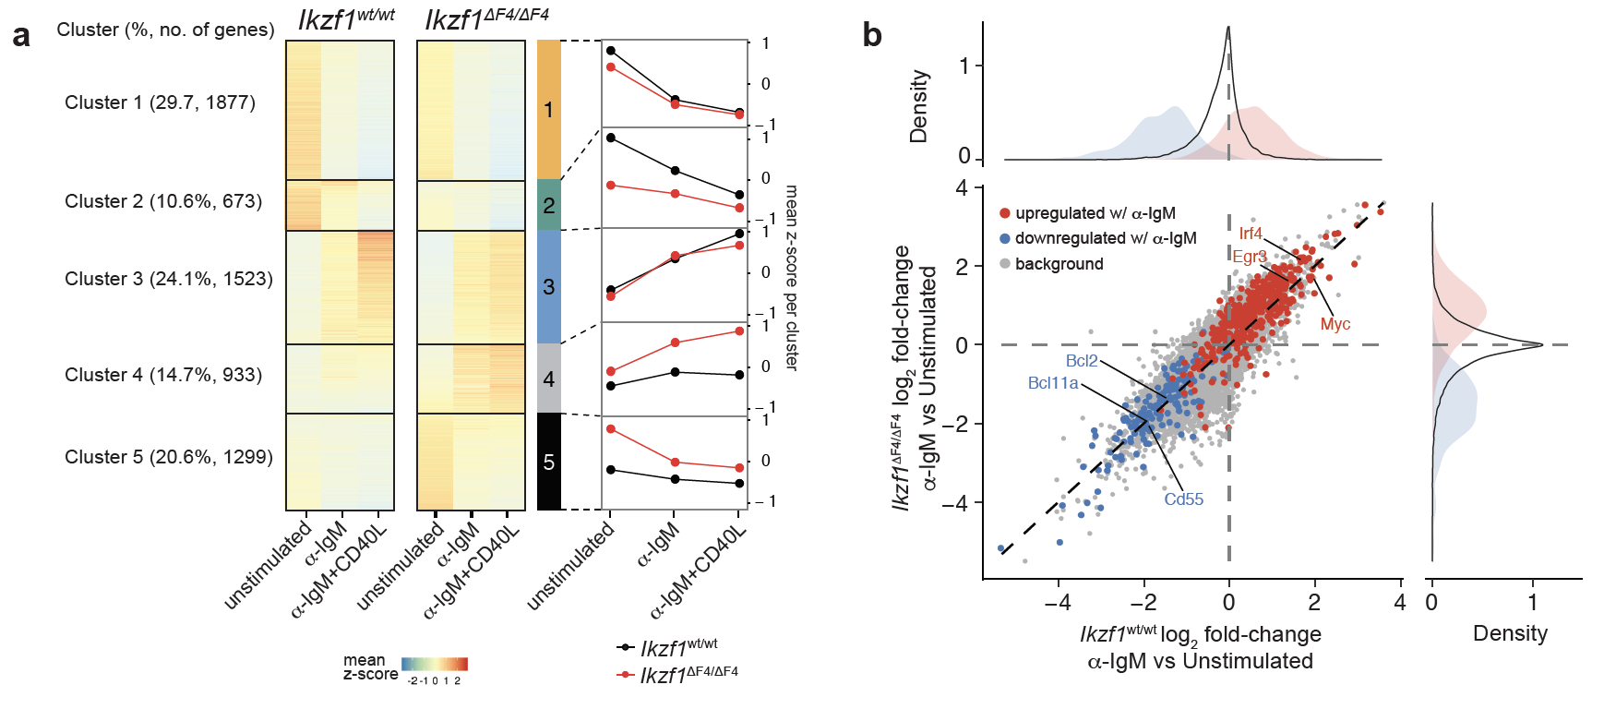

Slide 32

Please have a Goal with the Final Project
This will instill a sense of purpose
Do not lose sight of this
This should be your compass forward.

Slide 33
Overview for today’s lecture
Update in Course Grading
Unit 1 recap
Final project recap
Unit 2
Download dataset from GEO
Steps in Job submission – SLURM
Commands overview
Expectation/Output
Conda Download
Data management

Slide 34
Downloading data from GEO:
Collect SRR Numbers using RUN SELECTOR
Download SRA-ToolKit and set up
Run sra_fqdump.sh script
Use output from step #1
To run this script, we need first need to understand how to submit a job using SLURM

Slide 35
Submission of jobs
Submitting a job to an HPC machine (such as Bluemoon or DeepGreen) is done using the batch system.
The batch system allows users to submit jobs requesting the resources (nodes, processors, memory, GPUs) that they need.
The jobs are queued and then run as resources become available.
The batch system is called SLURM

Slide 36
Basic Steps to Job Submission:
1. Log in to VACC
2. Write job script
3. Submit Job
4. Monitor job and wait for it to run
5. Retrieve your output

Slide 37
Basic Steps to Job Submission:
1. Log in to VACC
2. Write job script
3. Submit Job
4. Monitor job and wait for it to run!
5. Retrieve your output
Requires an understanding of SLURM directives

Slide 38
What are SLURM Directives?
At the top of the job script will always be several lines that start with #SBATCH.
The SLURM directives provide the job setup information used by Slurm.
This information is then followed by the commands to be executed in the script.

Slide 39
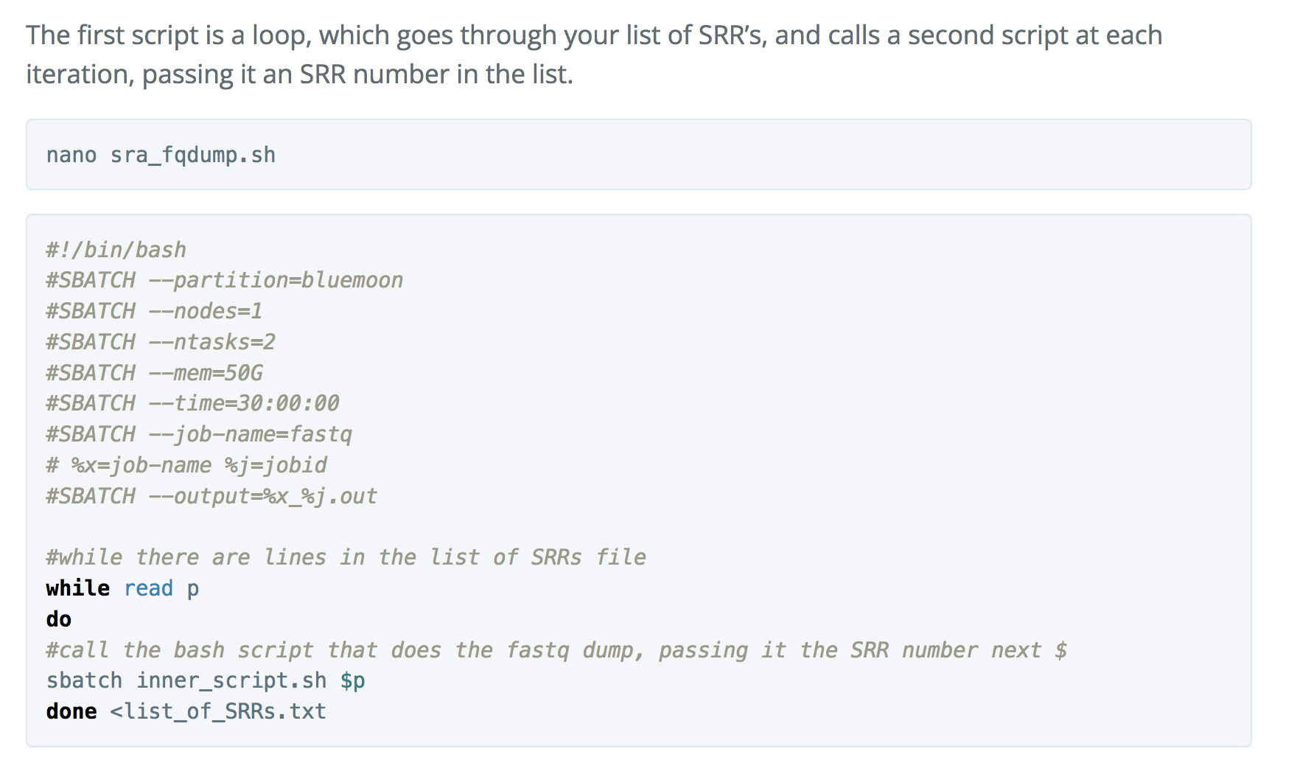
Quick look inside sra_fqdump.sh
1.
SLURM DIRECTIVES
2.
CODE

Slide 40
Common SLURM Directives
#!/bin/bash
#SBATCH --partition=bluemoon
#SBATCH --nodes=1
#SBATCH --ntasks=2
#SBATCH --mem=50G
#SBATCH --time=30:00:00
#SBATCH --job-name=RNAseq
# %x=job-name %j=jobid
#SBATCH --output=%x_%j.out
shebang = used to tell the LINUX OS which interpreter to use

Slide 41
Common SLURM Directives
partition = default is bluemoon if not specified
Other partitions are available.
This is important to know as some jobs will take longer to run!
#!/bin/bash
#SBATCH --partition=bluemoon
#SBATCH --nodes=1
#SBATCH --ntasks=2
#SBATCH --mem=50G
#SBATCH --time=30:00:00
#SBATCH --job-name=RNAseq
# %x=job-name %j=jobid
#SBATCH --output=%x_%j.out

Slide 42
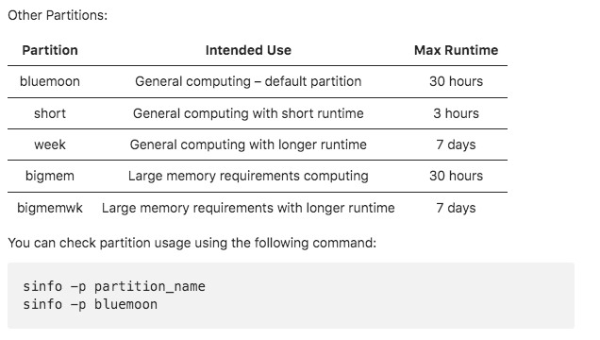

Slide 43
Common SLURM Directives
Node: A “node” is a server in the cluster. Each node has is configured with a certain number of cores (CPUs).
Task: A “task” is a process sent to a core. By default, 1 core is assigned per 1 task
Recommend that you begin with 1 node and 2 processes
#!/bin/bash
#SBATCH --partition=bluemoon
#SBATCH --nodes=1
#SBATCH --ntasks=2
#SBATCH --mem=50G
#SBATCH --time=30:00:00
#SBATCH --job-name=RNAseq
# %x=job-name %j=jobid
#SBATCH --output=%x_%j.out

Slide 44
Common SLURM Directives
#!/bin/bash
#SBATCH --partition=bluemoon
#SBATCH --nodes=1
#SBATCH --ntasks=2
#SBATCH --mem=50G
#SBATCH --time=30:00:00
#SBATCH --job-name=RNAseq
# %x=job-name %j=jobid
#SBATCH --output=%x_%j.out
If your job requires more than 1G of memory – need to specify this

Slide 45
Common SLURM Directives
#!/bin/bash
#SBATCH --partition=bluemoon
#SBATCH --nodes=1
#SBATCH --ntasks=2
#SBATCH --mem=50G
#SBATCH --time=30:00:00
#SBATCH --job-name=RNAseq
# %x=job-name %j=jobid
#SBATCH --output=%x_%j.out
Walltime is the maximum amount of time your job will run.

Slide 46
Location of scripts
cp -r /gpfs1/cl/mmg232/ course_materials/download_from_SRA .

Slide 47
Look inside sra_fqdump.sh
Make unique-add userid or some other identifier

Slide 48
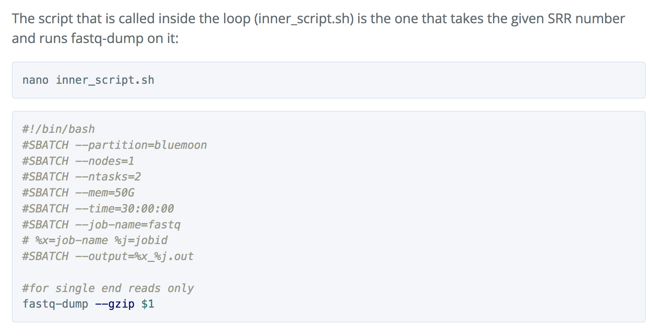
inner_script.sh

Slide 49
Fastq-dump --gunzip SRR#1 -> .out file #1
Fastq-dump --gunzip SRR#2 -> .out file #2
Fastq-dump --gunzip SRR#3 -> .out file #3

Slide 50
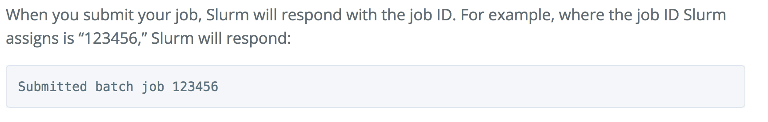
To run script use sbatch command:
sbatch sra_fqdump.sh

Slide 51
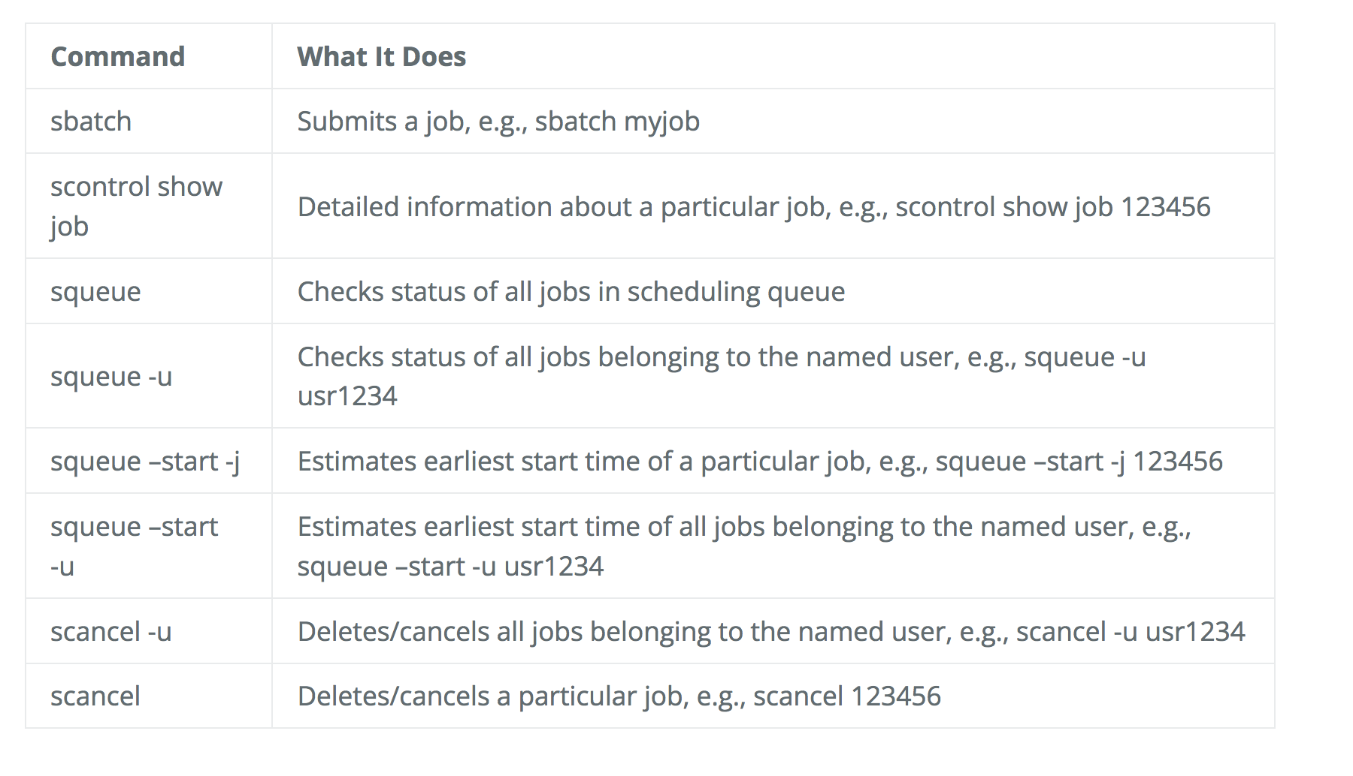
Other important commands:

Slide 52
Recording the output of programs
Three data streams exist for all Linux programs
STDIN (Standard Input - a way to send data into the program)
STDOUT (Standard Output - a way to send expected data out of the program)
STDERR (Standard Error - a way to send errors or warnings out of the program)
STDOUT STDERR
STDIN
program
By default STDOUT and STDERR are connected to your shell, so when you see text coming from a program, it's coming from these streams.

Slide 53
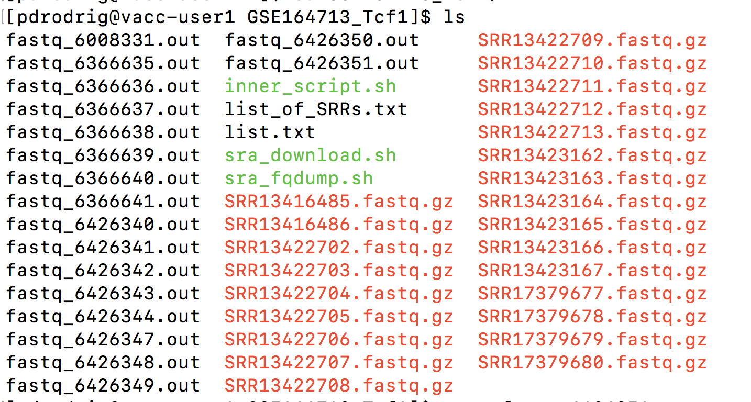
These will be redirected to .out files

Slide 54
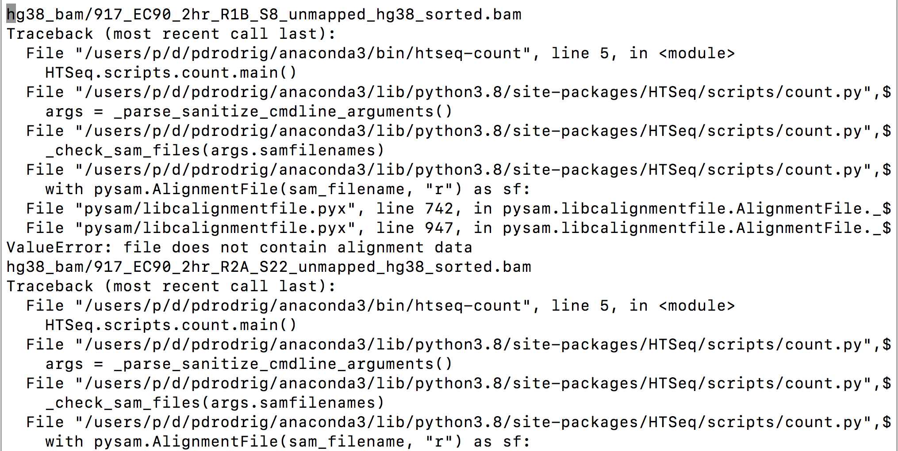
Any errors will be recorded in these .out files

Slide 55
Overview for today’s lecture
Update in Course Grading
Unit 1 recap
Final project recap
Unit 2
Download dataset from GEO
Steps in Job submission – SLURM
Commands overview
Expectation/Output
Conda Download
Data management
Metafile generation

Slide 56
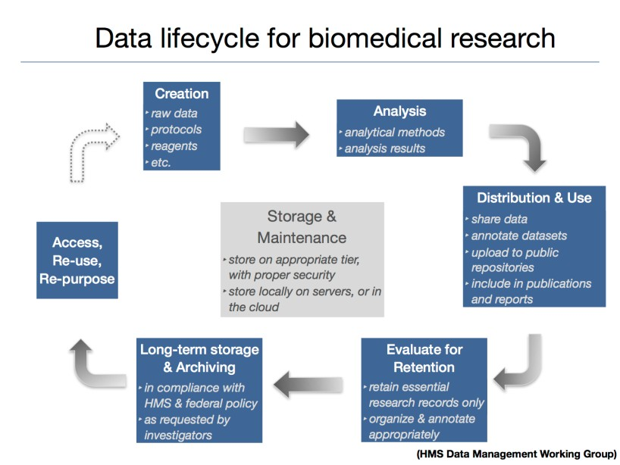
Data life-cycle

Slide 57
Data management planning
Consider the datatype and file sizes. How much total raw data do you have?
Consider the type of analyses you plan on performing.
What types of intermediate data files will I generate?
What is the best way to organize my directory structure?

Slide 58


Data types: Raw data
For NGS experiments, these are the FASTQ files you obtain from your sequencing facility or GEO
This data should never be directly modified (i.e. always keep a copy of this stored somewhere, untouched from its original state)

Slide 59
Keep
Delete
Delete
FASTQ.gz
Trimmed.FASTQ.gz
SAM
2-5GB
2-5GB
12-15GB
Keep
BAM
> 1GB

Slide 60
Keep
Delete
Delete
FASTQ.gz
Trimmed.FASTQ.gz
SAM
2-5GB
2-5GB
12-15GB
Keep
BAM
> 1GB
Files you are collecting using sratoolkit
Fastq-dump
You will need to collect information about the data you are processing

Slide 61
Metadata
Metadata are data that provide information about the data you are processing
Metadata exists to give data context
In genomics or transcriptomics, metadata describes the sample that the DNA/RNA sequence was obtained from, the organism, the cell line, and library preparation method

Slide 62
Submitting HTS data to GEO
https://www.ncbi.nlm.nih.gov/geo/info/seq.html
Homework assignment #1: HTS_GEO_submission_template.xlsx

Slide 63
Overview for today’s lecture
Update in Course Grading
Unit 1 recap
Final project recap
Unit 2
Download dataset from GEO
Steps in Job submission – SLURM
Commands overview
Expectation/Output
Conda Download
Data management

Slide 64
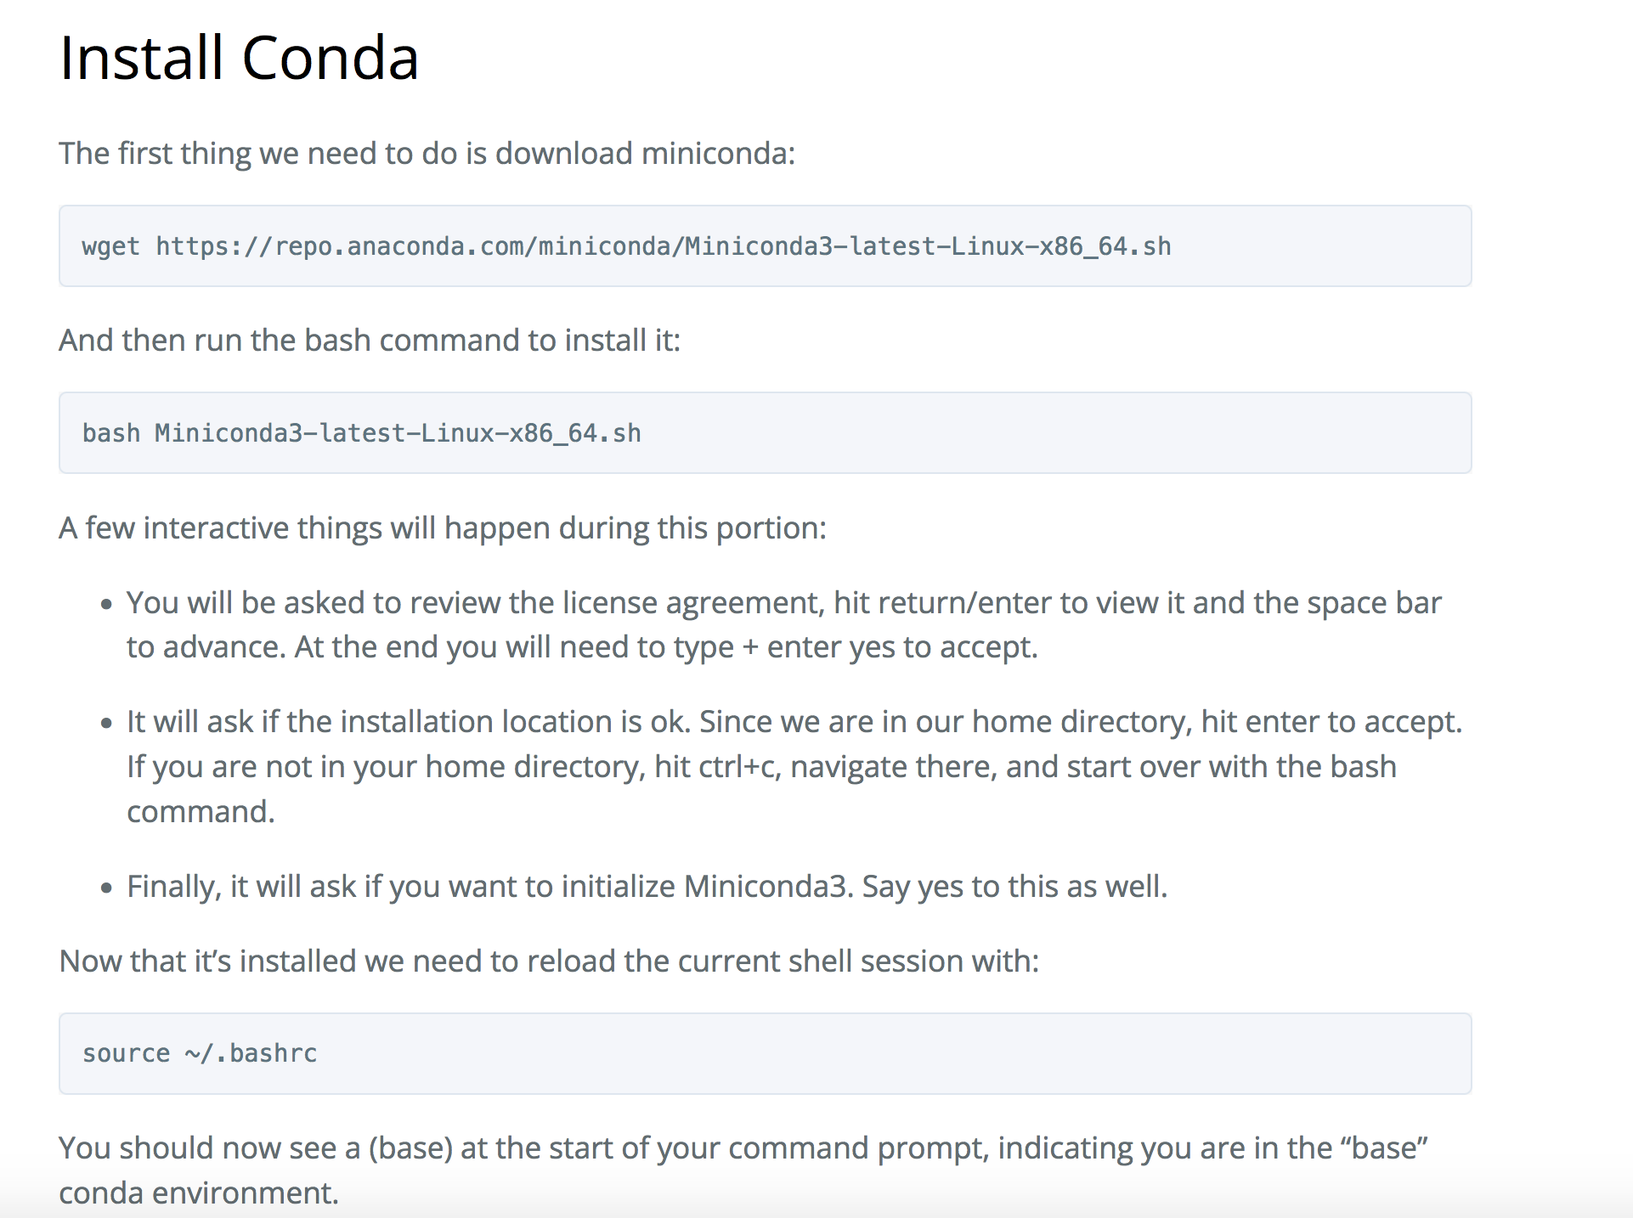
Conda download

Slide 65
